Slide 1
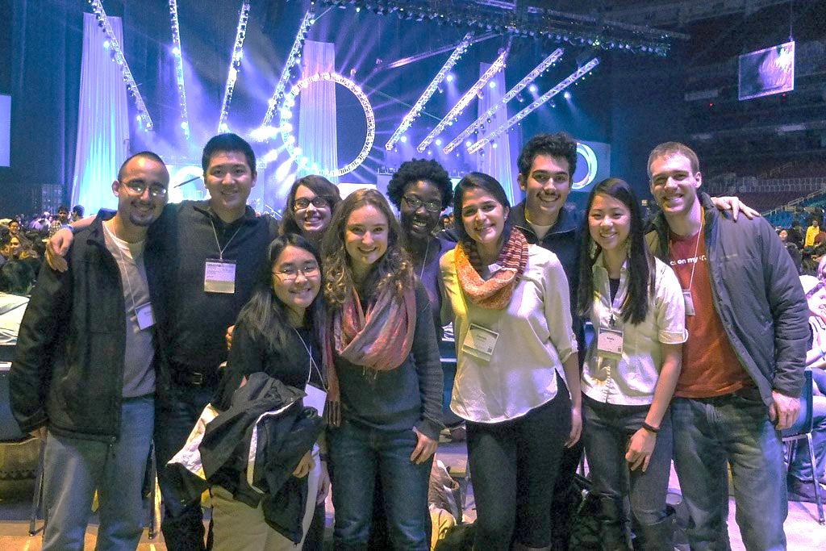
Reverse the 70% College Faith Loss
Minimize College Debt
7pm Tue APR 5th at
Faith Fellowship Christian School
BelieversCollegePrep.com/Watertown

