Slide 1
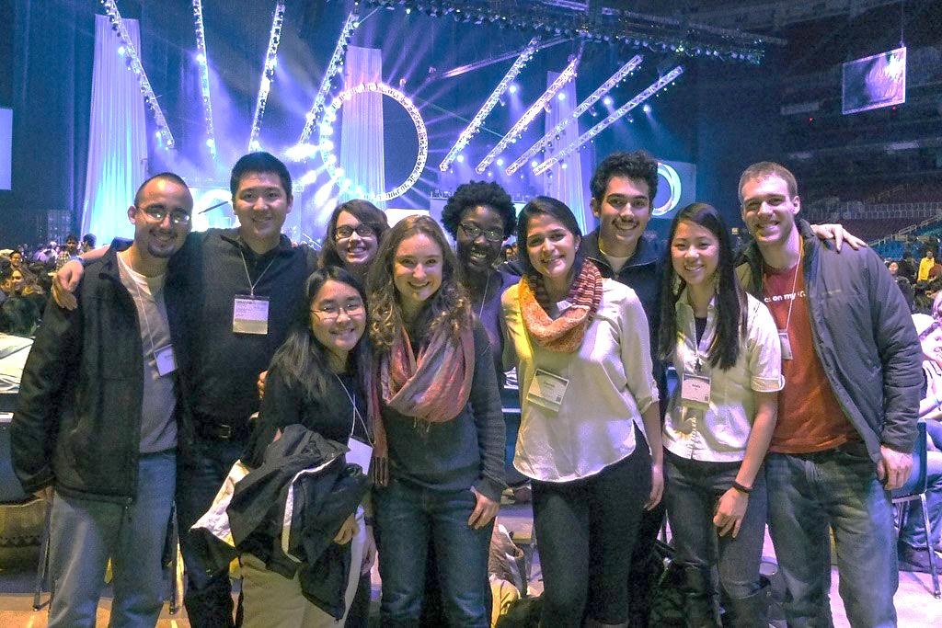
Know a College-Bound Student?
and many others…
Connect students to campus ministries
before they leave home!
BelieversCollegePrep.com

